Slide 1
edgecore product rework request process
Ann Chung<ann302_chung@edge-core.com>
2025/10/17

Slide 2
How to submit the product rework request on the edgecore Zendesk system

Slide 3
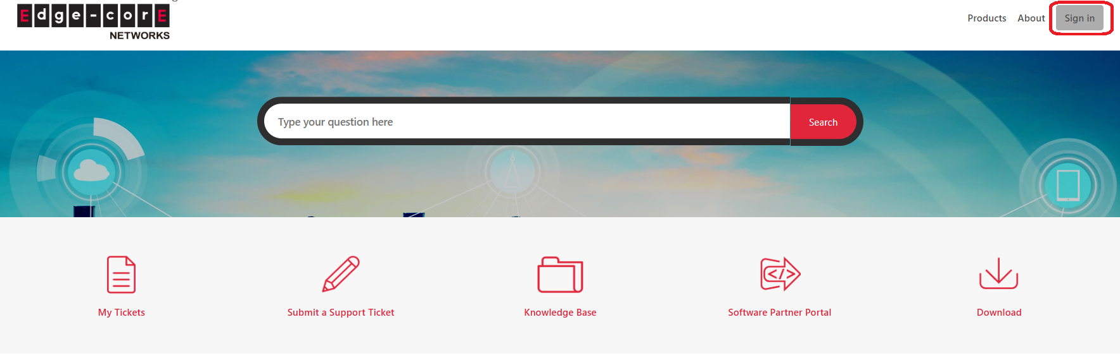
How to login the Zendesk system
1) Click the below Zendesk system.
edgecore zendesk system
2)Click the sign in icon.

Slide 4
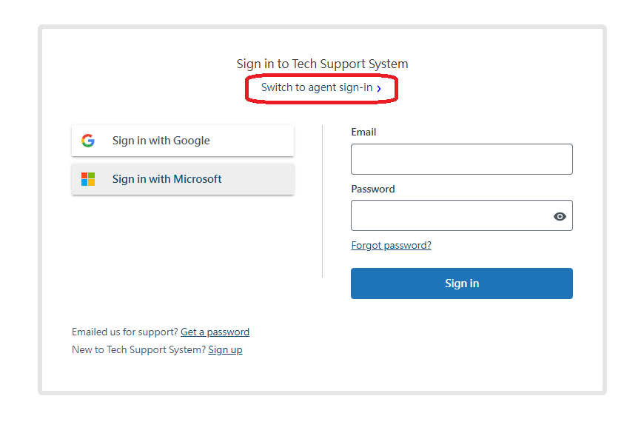
3)Click the switch to agent sign-in.
Note: It will use your Edgecore account password to log in.

Slide 5
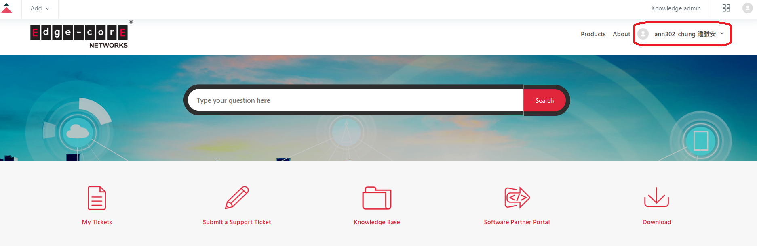
4) At this time, you will see the your account as red frame.

Slide 6
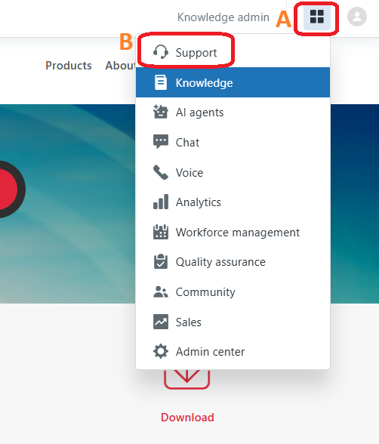
5) First, click the A icon, then click the B icon.

Slide 7
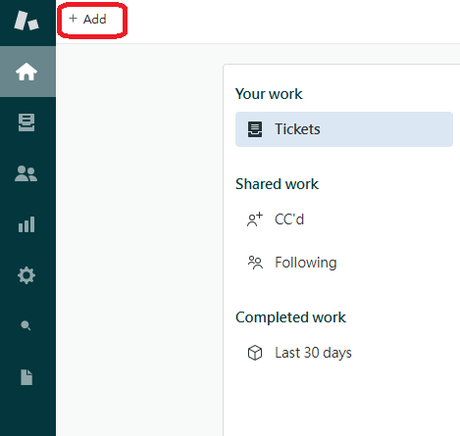
How to submit the rework request on Zendesk system
1) Click the +add icon.

Slide 8
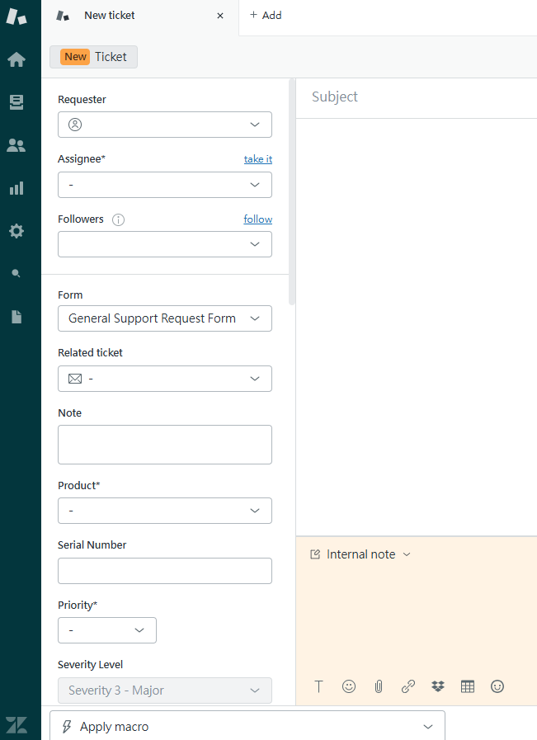
2) At this point, you will see a new ticket.

Slide 9
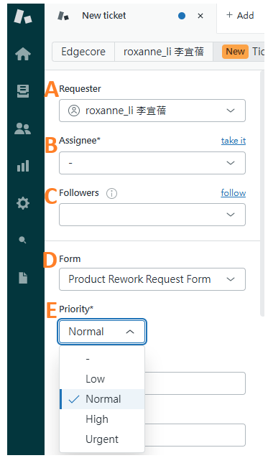
How to fill in the fields of the product rework form
A: Requester
Fill in your name. Here I use Roxanne as an example.
B: Assignee
The system will assign to Ann directly, so you don't need to fill it in.
C: Followers
For this rework, please also include the employee who needs to be informed by adding their name.
D: Form
Select the Product Rework Request Form.
E: Priority
Please check the urgency of your rework.

Slide 10
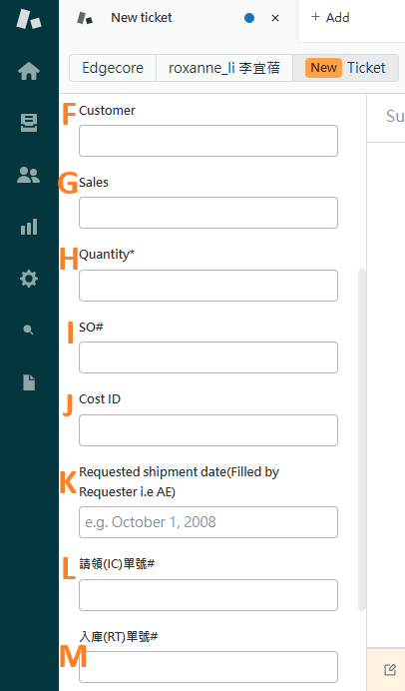
How to fill in the fields of the product rework form
F: Customer
Customers who fill in the rework requirements.
G: Sales
Fill in the salesperson for this rework request.
H: Quantity
Fill in the quantity required for this rework.
I: SO#
Fill in the order number for this rework request.
J: Cost ID
Fill in the cost ID for this rework request.
K: Requested shipment date(Filled by Requester i.e AE)
Fill in the shipment date for this rework request.
L: 請領(IC)單號#
Fill in the IC number for this rework request.
M:入庫(RT)單號#
Fill in the RT number for this rework request.

Slide 11
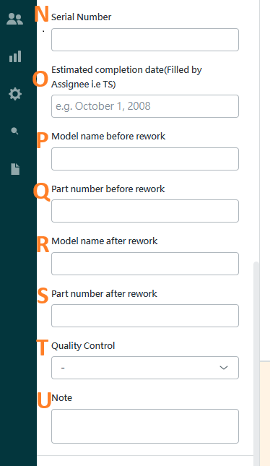
How to fill in the fields of the product rework form
N: Serial Number
The serial number has not been obtained yet, so there’s no need to fill it in.
O: Estimated completion date(Filled by Assignee i.e TS)
This field is filled in by TS
P: Model name before rework
Fill in the model name before the rework.
Q: Part number before work
Fill in the part number before the rework.
R: Model name after rework
Fill in the model name after the rework.
S: Part number after work
Fill in the part number after the rework.
T: Quality Control
If you need QA to do QC, please fill in.
U: Note
Fill in the notes.

Slide 12
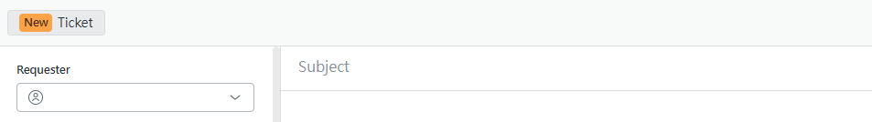
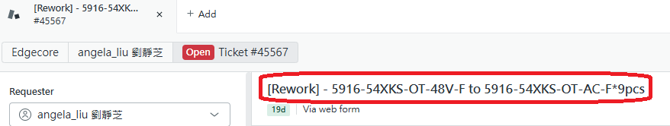
Fill in the rework subject
Fill in the rework subject.
The following diagram is for reference.

Slide 13
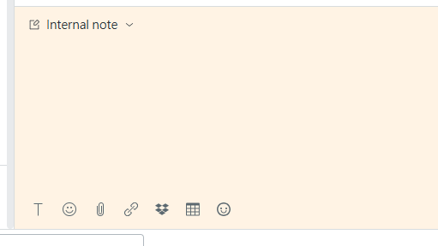
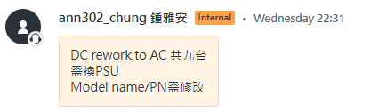
Fill in the rework content
Please fill in the rework content on internal note.
The following diagram is for reference.

Slide 14
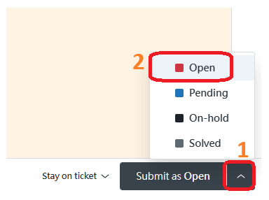
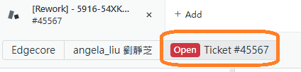
Submit the rework ticket
Select the inverted triangle icon then select Open icon to submit rework request.
After submitting successfully, you will see the following ticket number.

Slide 15
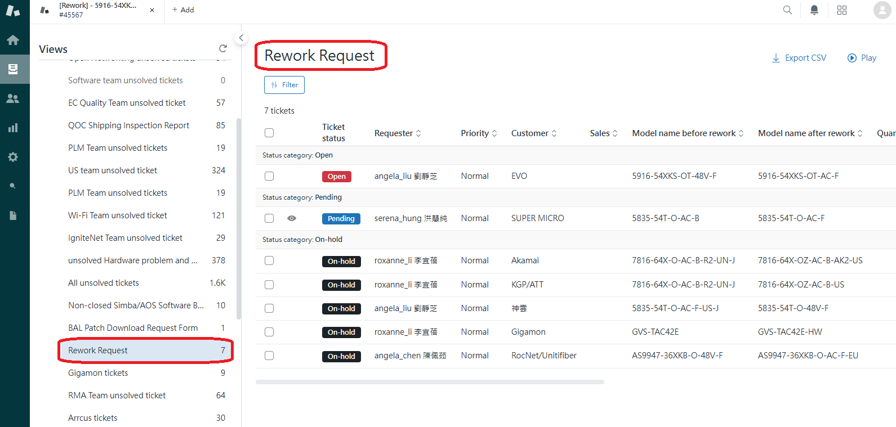
To view the rework list, please click on the rework request on the left, and the entire rework list will be displayed.

